Slide 1
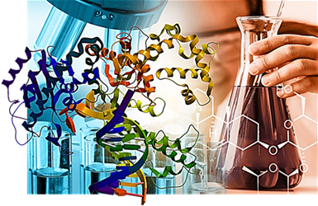
Lesson #2: Functional groups

Slide 2
Learning goals
Be able to explain how the carbon atom can form diverse molecules
Draw and identify the various functional groups
State the chemical properties attributed to each of the functional groups, and their general role in a cell

Slide 3
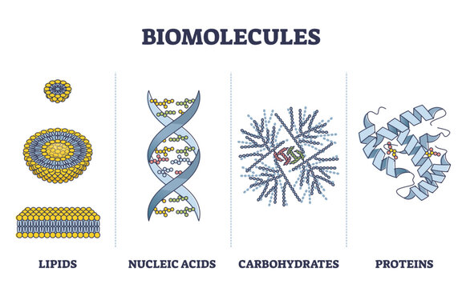
Biological macromolecules
Carbohydrates, lipids, proteins, and nucleic acids
They are the key molecular compounds used to build cells, store energy, and acts as chemical signals and enzymes … i.e. so, everything!

Slide 4
Biological macromolecules
Macromolecules are organic compounds
Carbohydrates, lipids, proteins, and nucleic acids are all composed of carbon atoms bonded to each other and to atoms of other elements
Can you name any?
These other elements commonly include hydrogen (H), oxygen (O), nitrogen (N), sulfur (S), and phosphorus (P) → “SPONCH”
Notes:
Essential for the formation of organic molecules and account for over 95% of the mass in living cells.
These non-metal elements are the fundamental building blocks for macromolecules like proteins, carbohydrates, lipids, and nucleic acids, which are vital for the structure and function of all known living organisms.

Slide 5
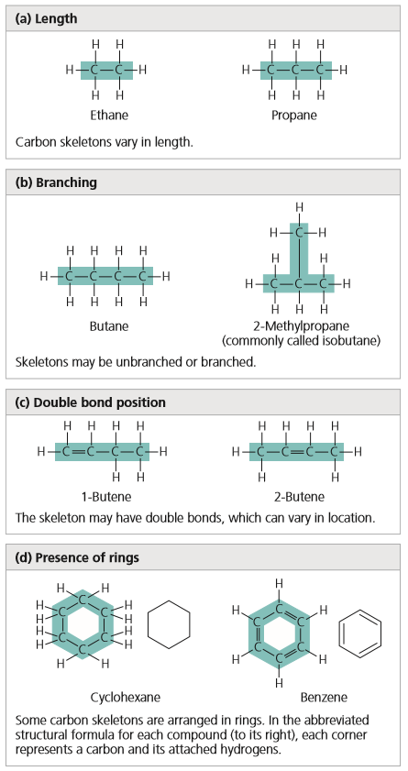
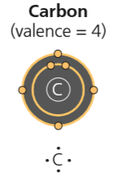
carbon
Why is carbon so important to life?
Carbon has 4 valence electrons → ability to make 4 covalent bonds with many different elements
This tetravalence of carbon makes large and complex molecules possible
The chain of carbon atoms in a biochemical molecule is the carbon skeleton: it can be linear or a branched chain, or even a ring
Molecular diversity!
Notes:
Carbon enters the biosphere through the action of producers—plants and other photosynthetic organisms that use solar energy to transform atmospheric CO₂ into the carbon-based molecules of life.
Carbon is unparalleled in its ability to form molecules that are large, complex, and varied, making possible the diversity of organisms that have evolved on Earth.
Such variation in carbon skeletons is one important source of the molecular complexity and diversity that characterize living matter.
In addition, atoms of other elements can be bonded to the skeletons at available sites.

Slide 6
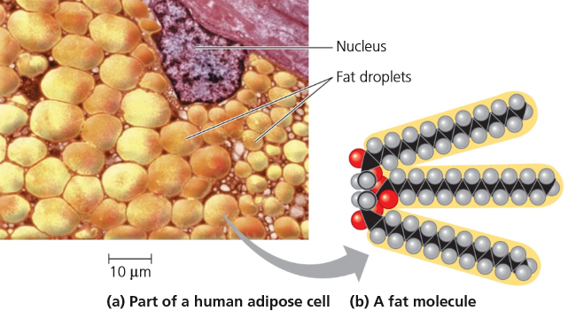
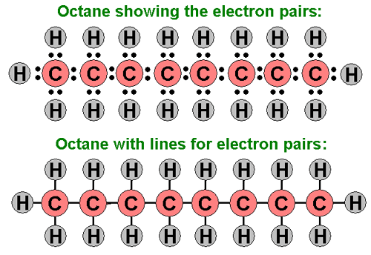


Carbon chains
Molecules made of C and H are called hydrocarbons, and have:
a symmetrical shape
an even distribution of electrical charges
$∴$ non-polar, and generally non-reactive with other molecules
Notes:
All living organisms are composed of primarily of carbon, C; hydrogen, H; and oxygen, O.
Molecules of living organisms contain other elements in addition to C and H.
These other elements give biological molecules different functional properties.
Ethane – CH3CH3 vs. ethanol - CH3CH2OH

Slide 7
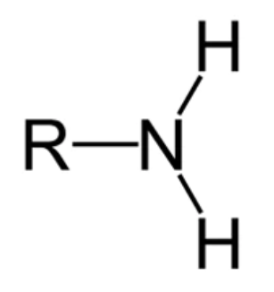
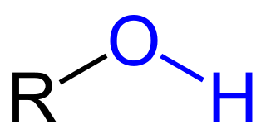
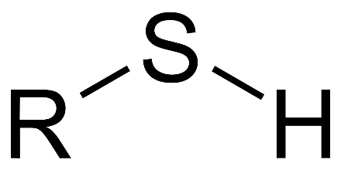
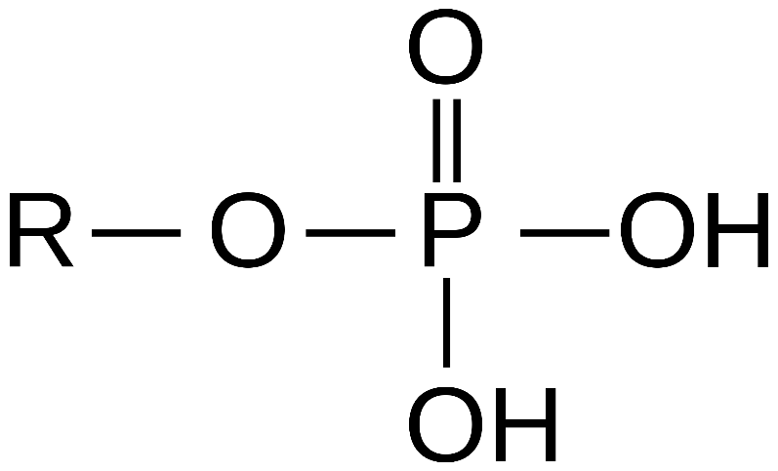
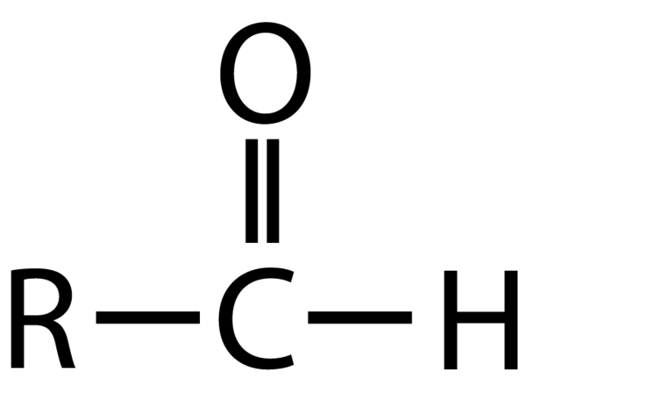
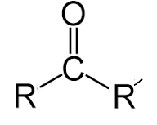
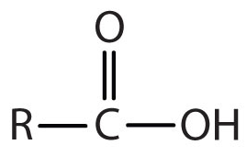
Functional groups
Functional groups are the part of organic molecules that are involved in chemical reactions
Functional groups are covalently bonded to a hydrocarbon skeleton
Contain P, O, N, or S
The number and arrangement of functional groups help give each molecule its unique properties (i.e. how it functions)!

Slide 8
Functional groups

Slide 9

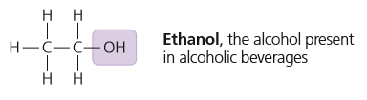
Hydroxyl
Formula: -OH (or HO-)
Structure: a hydrogen atom is bonded to an oxygen atom, which in turn is bonded to the carbon skeleton of the organic molecule
Family of molecules: alcohols
Example: ethanol
Properties:
Polar → electronegative oxygen
Hydrophilic (“water-loving”) → attracts water molecules through hydrogen bonding → increases solubility
Notes:
Is polar due to electronegative oxygen.
Forms hydrogen bonds with water, helping dissolve compounds such as sugars.

Slide 10
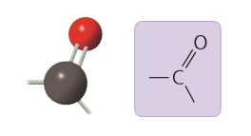
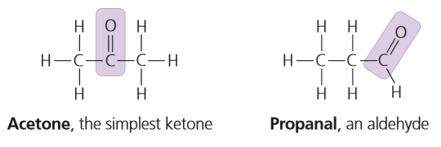
Carbonyl
Formula: C=O
Structure: consists of a carbon atom joined to an oxygen atom by a double bond
Family of molecules: ketones (within) and aldehydes (end)
Example: acetone and propanal
Properties:
Polar → electronegative oxygen
Hydrophilic (“water-loving”) → attracts water molecules through hydrogen bonding → increases solubility
Notes:
Ketone (carbonyl group is within a carbon skeleton) or aldehyde (carbonyl group is at the end of a carbon skeleton).

Slide 11
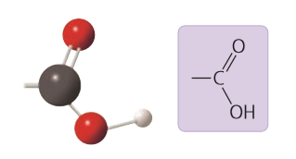
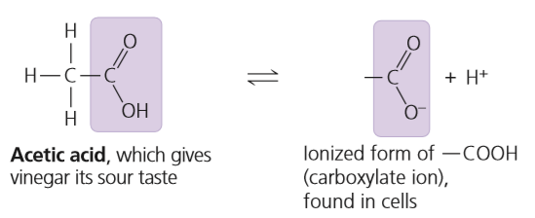
Carboxyl
Formula: -COOH
Structure: an oxygen atom is double-bonded to a carbon that is also bonded to a hydroxyl group
Family of molecules: carboxylic acids
Example: acetic acid (vinegar)
Properties:
Polar → electronegative oxygen
Hydrophilic (“water-loving”) → attracts water molecules through hydrogen bonding → increases solubility
Acts as an acid (can donate H⁺) when dissolved in water
Non-ionized
Ionized
Notes:
Hydrogen atom loses its electron, leaving only the positively charged proton behind (H ion = H proton).
A "weak acid" is a compound that similarly does not completely dissociate in water, only releasing a small amount of hydrogen ions (H+) when dissolved.

Slide 12
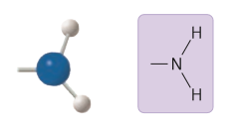
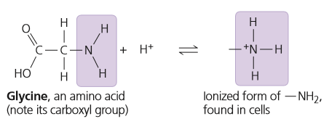
Amino
Formula: -NH₂
Structure: consists of a nitrogen atom bonded to two hydrogen atoms and to the carbon skeleton
Family of molecules: amines
Example: glycine
Properties:
Polar → electronegative nitrogen
Hydrophilic (“water-loving”) → attracts water molecules through hydrogen bonding → increases solubility
Acts as a base (accept donate H⁺) when dissolved in water
Non-ionized
Ionized
Notes:
Glycine has both an amino and carboxyl group = amino acid.
A "weak base" is a chemical compound that does not fully ionize when dissolved in water, meaning it only partially releases hydroxide ions (OH-) in solution, or does not fully ionize.

Slide 13
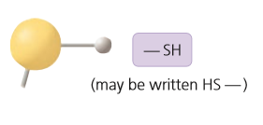
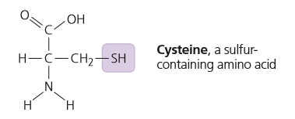
Sulfhydryl
Formula: -SH (HS-)
Structure: consists of a sulfur atom bonded to an atom of hydrogen
Family of molecules: thiols
Example: ethanethiol
Properties:
Slightly polar → electronegative sulfur
Somewhat hydrophilic (“water-loving”) → attracts water molecules through hydrogen bonding → increases solubility
Notes:
Sulfur atoms in the side chain have a lone pair of electrons which can be easily shared with another sulfur atom to form a disulfide bond (S – S) – covalent bond

Slide 14
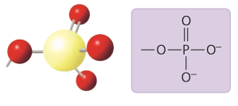
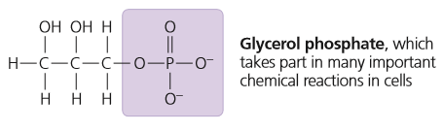
Phosphate
Formula: -OPO₃²⁻
Structure: a phosphorus atom is bonded to four oxygen atoms; one oxygen is bonded to the carbon skeleton; one is double-bonded to phosphorus; two oxygens carry negative charges
Family of molecules: organic phosphates
Example: glycerol phosphate
Properties:
Polar → electronegative oxygen
Hydrophilic (“water-loving”) → attracts water molecules through hydrogen bonding → increases solubility
Acts as an acid (can donate H⁺) when dissolved in water
Ionized

Slide 15
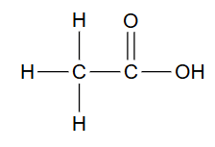
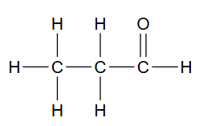
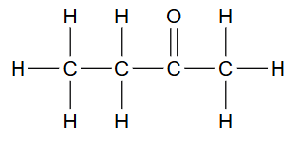
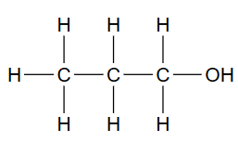
Try these!

Slide 16
Learning check
What does the term amino acid signify about the structure of such a molecule?
Suppose you had an organic molecule such as cysteine (sulfhydryl group example), and you chemically removed the —NH₂ group and replaced it with —COOH. Draw this structure. How would this change the chemical properties of the molecule?
Notes:
Answers:
It has both an amino group (¬NH2), which makes it an amine, and a carboxyl group (¬COOH), which makes it a carboxylic acid.
2. A chemical group that can act as a base has been replaced with a group that can act as an acid, increasing the acidic properties of the molecule. The shape of the molecule would also change, likely changing the molecules with which it can interact.

Slide 17
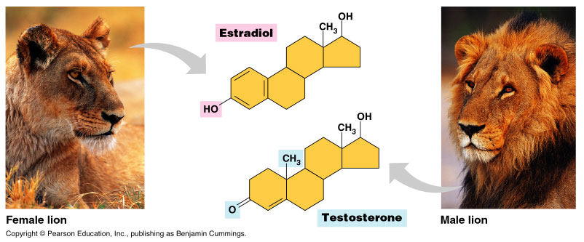
Functional groups & biology
The basic structure of testosterone (male hormone) and estradiol (female hormone) is identical
Both are steroids with four fused carbon rings, but they differ in the functional groups attached to the rings.
These then interact with different targets in the body producing contrasting features of males and females!
Notes:
Estradiol has hydroxyl instead of a ketone.
Sexuality has its biological basis in variations of molecular architecture.

Slide 18
Summary
Carbon, with a valence of 4 (tetravalence), can bond to various other atoms, including O, H, and N. Carbon can also bond to other carbon atoms, forming the carbon skeletons of organic compounds. These skeletons vary in length and shape and have bonding sites for atoms of other elements.
Hydrocarbons consist of carbon and hydrogen.
Chemical groups attached to the carbon skeletons of organic molecules participate in chemical reactions (functional groups) or contribute to function by affecting molecular shape.

